Slide 1
West Haverstraw Non-Wires Alternative Pre-Bid Conference
July 16, 2018

Slide 2
Agenda
Overview and Purpose
O&R NWA Process
West Haverstraw NWA Overview
Description of Need
Potential Solution Description
Vendor Information
RFP Schedule
Evaluation Criteria
Proposal Response and Submittal Process
Key Things to Note
Clarification Questions

Slide 3
Overview and Purpose
Through this webinar O&R intends to:
Describe the O&R Non-Wires Alternatives (NWA) process
Provide an overview of the West Haverstraw NWA RFP
Discuss evaluation criteria and process
Review next steps
This webinar is not intended to:
Answer specific questions about the RFP or process
Discuss need specifics

Slide 4
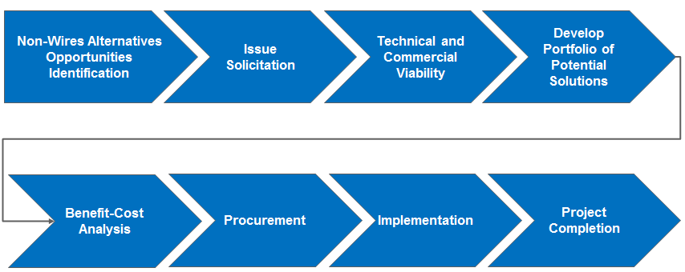
O&R’s NWA Process
The process shown below is an example of the high-level steps that occur during the identification of NWA solutions, as well as the evaluation, implementation, and verification of the identified solutions

Slide 5
West Haverstraw NWA Overview
West Haverstraw Area
West Haverstraw Substation #27 is a distribution substation located in the Village of West Haverstraw, NY, in Haverstraw Township within Rockland County. The substation feeds mostly residential customers along with some commercial and industrial customers

Slide 6
West Haverstraw NWA Overview (cont’d)
Objective
O&R is proposing to implement a NWA program in order to defer capital infrastructure investments to meet short- and long-term customer energy needs
The traditional wires solution that O&R is seeking to defer includes:
Construction of a new underground circuit from the West Haverstraw substation to the intersection of Route 202 and Route 9W

Slide 7
Description of Need
The Village of Haverstraw is served with three 13.2kV distribution circuits
Two of these distribution feeders are constructed as a double circuit spacer construction pole line for approximately one mile exiting from the substation
An interruption event occurring on this portion of the double circuit feeder can require the de-energization of both circuits in order to expedite the repairs
During peak summer loading periods, the remaining area circuit cannot support the entire load
Please visit O&Rs hosting capacity map (published publicly online) to get details on circuit orientation
Notes:
Specific needs are detailed in the RFP on a bank and circuit level.

Slide 8
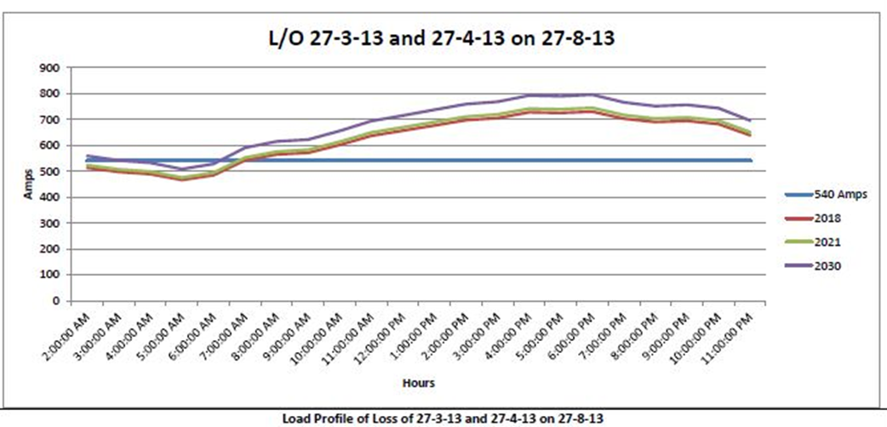
Description of Need (cont’d)
Total Hours in a summer = 5 months of summer * 30 days *24 hours = 3600 hours
Notes:
Specific needs are detailed in the RFP on a bank and circuit level.

Slide 9
Load Profile (Customer Demographic)
The three circuits feeding the Village of West Haverstraw presently serves 4,179 customers, the majority of which are residential
Customer Breakdown by Circuits
West Haverstraw Distribution Circuit | Customers*
 | Residential | C & I | Total
27-3-13 | 1,862 | 356 | 2,218
27-4-13 | 1,026 | 121 | 1,147
27-8-13 | 709 | 105 | 814
Total | 3,597 | 582 | 4,179
* As of June 1, 2018.

Slide 10
Potential Solutions
The RFP is focused on NWAs that will reduce peak demand in areas where capital investments are needed to improve system reliability and resiliency.
Alternatives may include the following DER:
Energy efficiency (“EE”)
Demand response (“DR”)
Clean (i.e., gas fired and solar) distributed generation (“DG”)
Energy storage (“ES”)
Any combination of technologies which may allow the Company to delay the construction of needed infrastructure
The company will leverage its existing EE and DR programs to lower the amount of DER that needs to be procured.
The company may entertain proposed EE and DR solutions that have the potential to enhance its existing programs.
Respondents are encouraged to submit alternative, creative proposals for marketing, sales, financing, implementation, and maintenance, or transaction structures and pricing formulas that will achieve the demand reductions sought and maximize value to O&R’s customers

Slide 11
Potential Solutions (Cont’d)
For proposals including Demand Response services:
An opportunity assessment including at a minimum:
A) a description of the markets, such as one-to-four family homes, multifamily buildings, small commercial (e.g., retail stores, restaurants), large commercial (e.g., office buildings, industrial) and government or institutional (e.g., hospitals, hotels, schools, colleges), and
B) the applicable demand management measures and technologies to be directed at each selected market or customer segment
Illustration of the marketing and sales strategies that they will employ to capture the selected market or customer segment and to deliver the demand reductions included in their proposals
Preference will be given to Respondents which have pre-existing customer agreements to deploy the solution
The Company is interested in proposals which will take advantage of funding available from other funding streams
In order to mitigate the cost impact on the Company’s customers it will be important to maximize the use of existing municipal, State and Federal funding opportunities
The ability to obtain private sector funding should also be identified

Slide 12
Vendor Information
Responses should include:
Any and all methods and procedures required to comply with technical, safety and operational requirements for the interconnection and operation of their equipment with O&R’s electric delivery system
For any proposed renewable generation, it is particularly important to verify that any stated demand reduction coincides with the Company’s peak loading period
Financial assurances that the committed amount of demand reduction measures will be installed and the committed in-service date for each measure will be met
Data and methodology used to determine the estimated demand reduction, annual kWh savings attributable to each measure/solution proposed to be installed, and methods/proposals to confirm measurement and verification of delivered demand reductions
Information on elements of the proposal that affect the community (both positively and negatively) including, but not limited to, associated greenhouse gas (“GHG”) emissions, waste streams and management, job creation potential and community disruption

Slide 13
RFP Schedule
The expected schedule* to be followed during this solicitation is below:
RFP Solicitation Milestones | Completion Date*
RFP Issued | June 29, 2018
Pre-bid conference call (see details below) | July 16, 2018 10:30-11:30 AM EDT
Deadline to submit clarification questions | July 23, 2018
Responses to clarification questions due | August 6, 2018
Deadline to become enabled in O&R/Con Edison procurement system | August 15, 2018
Qualified respondents proposals due | September 7, 2018, 3PM EDT
*O&R reserves the right to change any of the above dates.

Slide 14
Evaluation Criteria
Evaluation criteria will include but not be limited to:
Proposal content –Comprehensive proposal that addresses the need of the RFP
Viability - the extent to which the proposed solution would address the need
Functionality - the extent to which the proposed solution would provide the needed load reductions
Proposed NWA technology - the maturity of DER technology being proposed, ability to scale the DER technology, any challenges in deploying the proposed DER solution
Project Timeline and Implementation Plan - the ability to meet O&R’s schedule and project deployment requirements, also with a mind that the detailed project schedule from contract execution to implementation and completion of projects is important for determination of feasibility
Respondent Qualifications - Respondent’s relevant experience and success providing these solutions to other locations, including reference checks and documented results

Slide 15
Evaluation Criteria (Cont’d)
Price and reliability, respondents should provide the pricing for the project broken down as follows:
Respondent should itemize and identify various items in each of the cost buckets, i.e., material cost components, labor cost components
Applicability to REV- supports the goals and objectives outlined in the REV proceedings
Execution risk - the expected ease of project implementation within the timeframe required (e.g., permitting, construction risks, operating risks)

Slide 16
Proposal Response and Submittal Process
The following process should be used to submit proposals:
All proposals must be submitted through the Oracle RFQ System on or prior to the due date and time.
Respondents who fail to submit by the due date and time will be unable to submit their proposals.
Respondents are encouraged to upload their proposals well in advance of the closing time to avoid any potential issues that may occur
Respondents must take the following actions to ensure acceptance of a proposal submission:
Download the West Haverstraw Non-Wires Alternative RFP, Non-Wires Alternative Questionnaire, and Supplier Enablement Template.
Become enabled in the Oracle RFQ System* by submitting the below items to Michael Heaton at heatonm@coned.com
W-9 form (version last updated); and
Supplier Enablement Template (Select ‘Sourcing’ under Oracle responsibility field).
*Note: if a respondent has previously been enabled in the Oracle RFQ System as part of a separate bid event then they do not have to do it again, but should email Mike Heaton to notify him of participation interest for this RFP
Receive Formal RFQ response request (will be same information downloaded from non-wires alternative website).
Submit response and fully completed questionnaire to Oracle RFQ System prior to the deadline.

Slide 17
Key Things to Note
Terms and Conditions
Proposal response format and Terms and Conditions are included in the RFP
Clarification questions may be submitted via email through the Q&A process
EE and DR Solutions
The company will leverage its existing EE and DR programs to lower the amount of DER that needs to be procured
The company may also entertain proposed EE and DR solutions that have the potential to enhance its existing programs
Respondents may include proposals that require utility ownership, lease or PPA of the DER assets required for the NWA project

Slide 18
Clarification Questions
In order to ensure equal access to RFP information, O&R will accept, answer and respond to vendor questions according the following process:
During the clarification period, Respondents should direct clarification questions via email to Michael Heaton, heatonm@coned.com, of O&R’s/Con Edison’s Supply Chain Department.
The deadline for submitting clarification questions is midnight on July 16, 2018
O&R will have no obligation to evaluate late submissions, nor be responsible in any way for any consequences associated with late submissions
All questions and answers deemed essential for the viable submission of a bid response will be publicly posted at https://www.oru.com/en/business-partners/non-wires-alternatives
Respondent’s identities will be kept confidential.

Slide 19
Thank you!!

